Slide 1



HOTEL WEBSITE

Slide 2
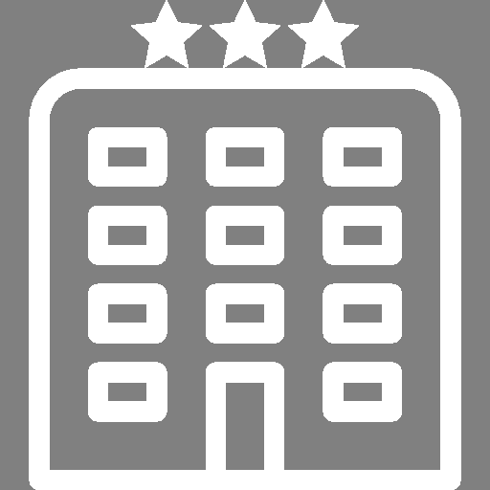
ABOUT
US
私たちに関しては
1

Slide 3

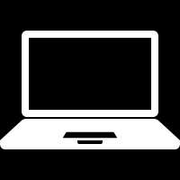
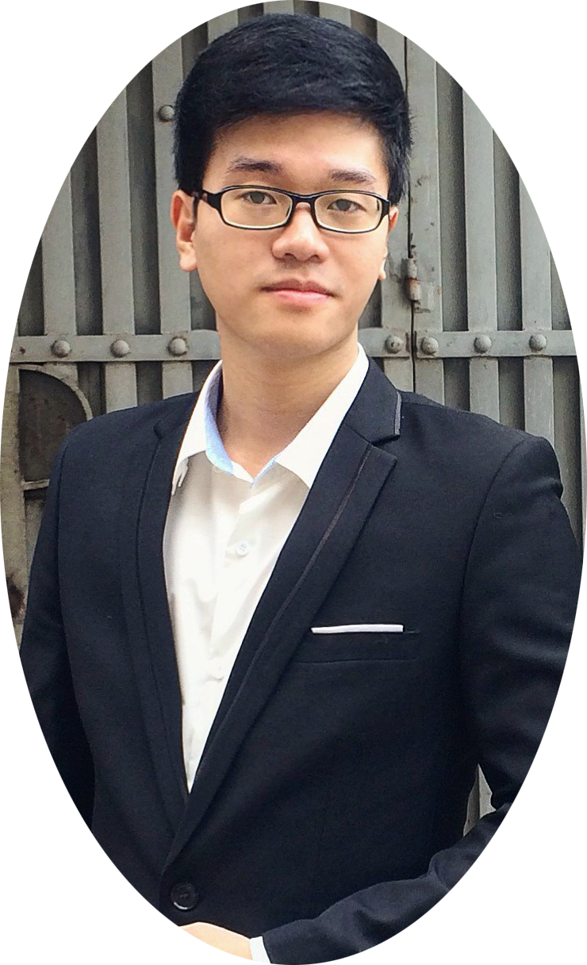
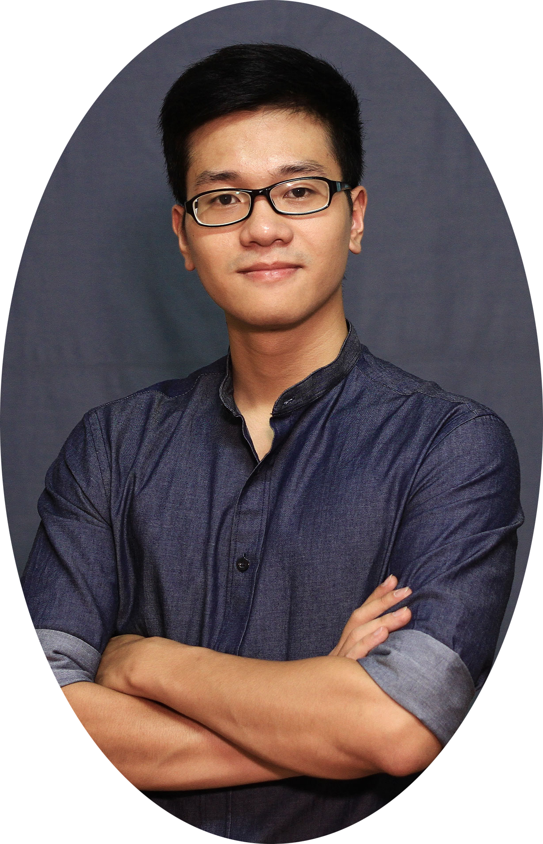
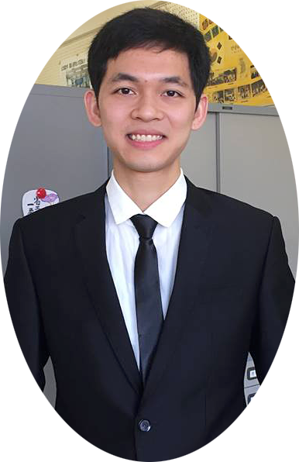
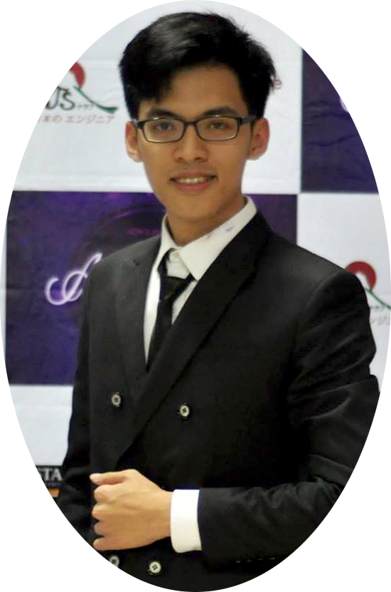
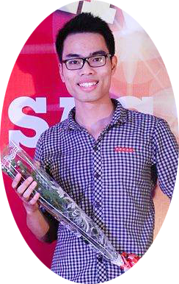
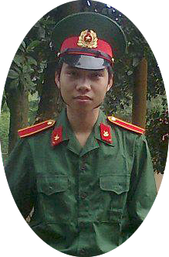
ABOUT US
Vu Tran Hoang
Team Member
Tran Ba Quyen
Team Member
Nguyen Viet Hung
Team Leader
- HOWE Team -
We are final year students of FPT University. With the tutorial of Mr.Phan Truong Lam,
we had successfully built this project
Dang Cong Son
Team Member
Dang Duc Manh
Team Member
2

Slide 4

Outlines
アウトライン
Q & A - 質問と回答
7
Demo - デモ
6
Software Testing
ソフトウェアテスト
5
Software Design Description
ソフトウェア 設計書
4
3
Software Requirement Specification
ソフトウェア要件仕様書
2
Software Project Management
プロジェクト管理
1
Background バックグラウンド
3

Slide 5
BACKGROUND
バックグラウンド
4

Slide 6
Background
バックグラウンド
First 3 months of 2017:
The total number of tourists to Quang Ninh was about 3,769 million times, up 12%
over the same period of 2016.
The number of tourists to Ha Long Bay was about 928,900 times.
The higher the number of tourists is, the greater the demand for
accommodation and hotel services increases, resulting in the establishment of
more hotels.
(http://baoquangninh.com.vn/du-lich/201703/quy-i-2017-quang-ninh-don-3769-trieu-luot-khach-du-lich-2336999/)
5

Slide 7

Background
バックグラウンド
Hotels face with difficulties in:
Booking.
Room services managing.
Using tools for management.
6

Slide 8

Background
バックグラウンド
IDEA
Develop a website to:
Brand the hotel’s image.
Offer customers with a time-saving and efficient booking way
Provide favorable tool for the hotel’s staffs.
7

Slide 9
PROJECT MANAGEMENT
プロジェクト管理
7

Slide 10
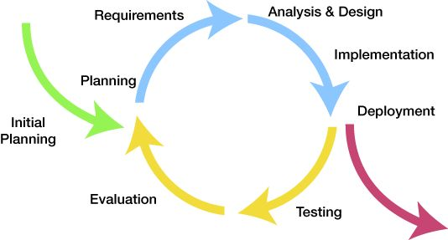
Project Management
プロジェクト管理
Software development process
ソフトウェア開発のプロセス
Iteration 1: May 08th – Aug 25th
Iterative Model
8

Slide 11
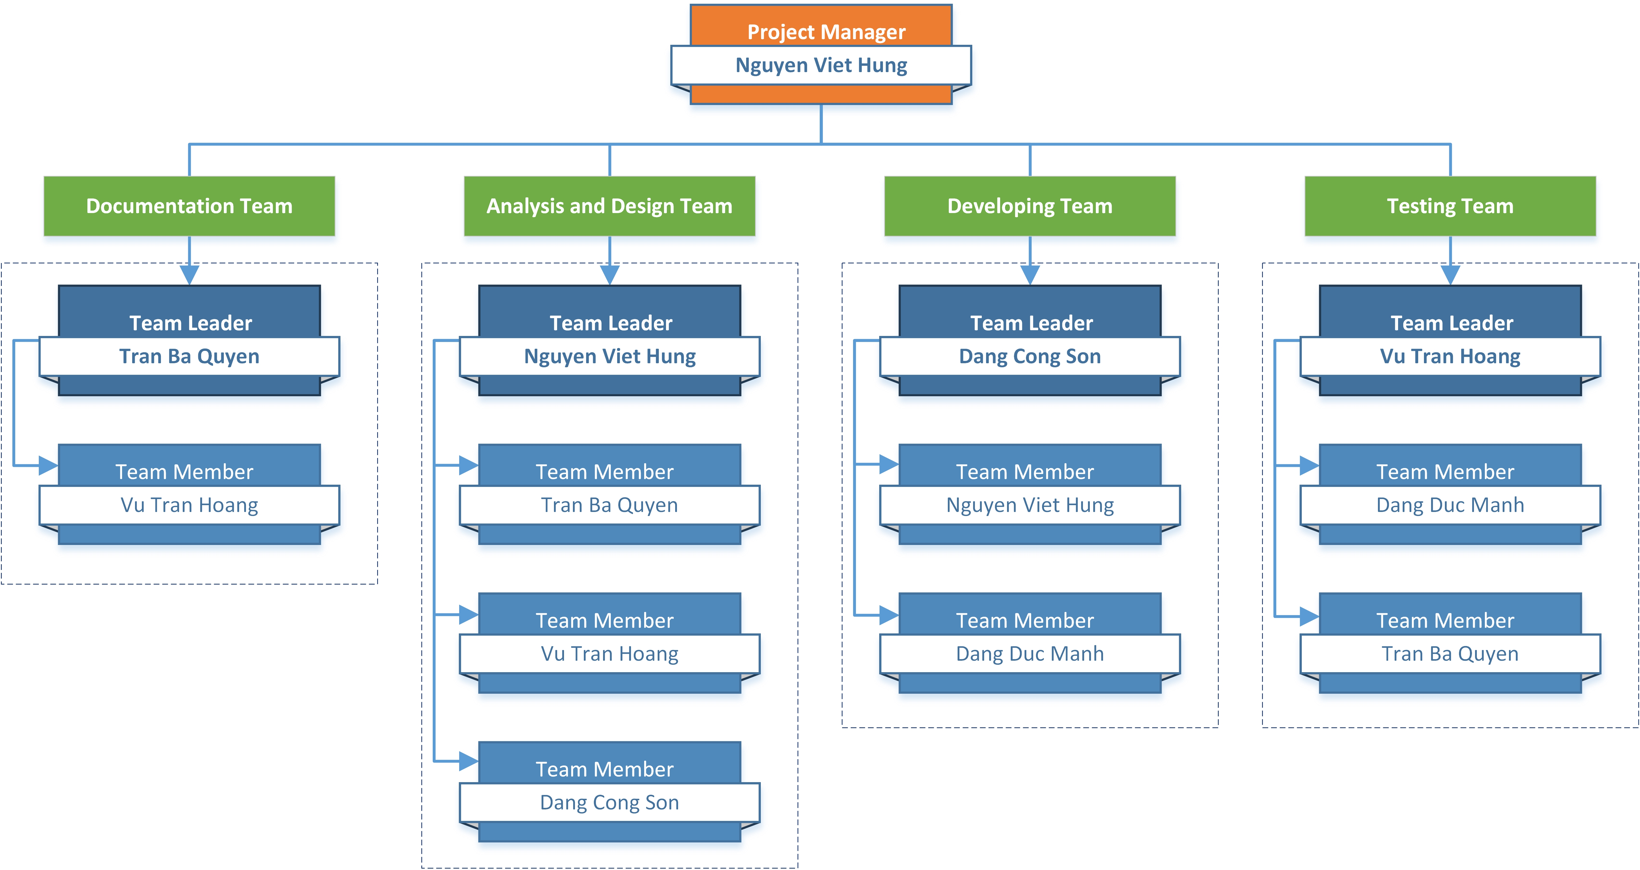
Project Management
プロジェクト管理
Organizational Structure - 組織構造
9

Slide 12
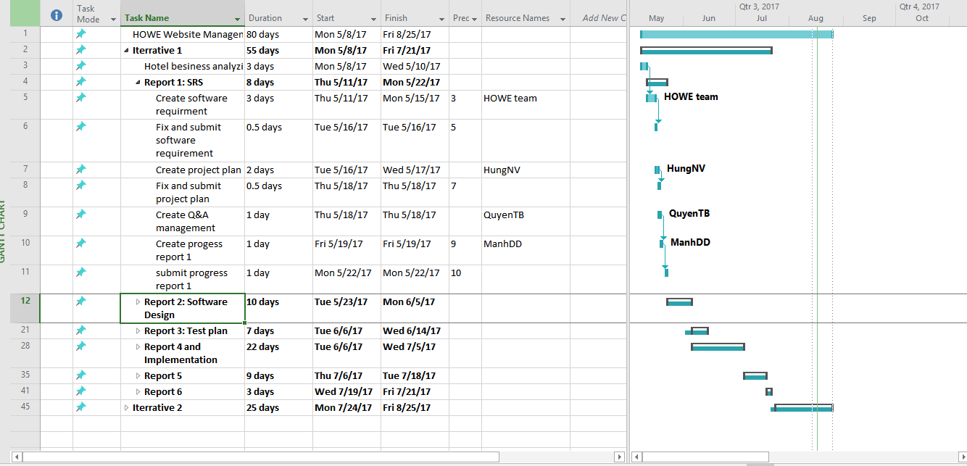
Project Management
プロジェクト管理
Project schedule - プロジェクトスケジュール
10

Slide 13





Project Management
プロジェクト管理
Tools & Infrastructure ツールと インフラストラクチャ
Tools used in project management
GitHub
Word 2016
Excel 2016
PowerPoint 2016
Project 2016
11

Slide 14







Project Management
プロジェクト管理
Project Infrastructure - プロジェクトインフラストラクチャ
Tools for developing
12

Slide 15
Project Management
プロジェクト管理
Risk Management - リスク管理
No | Name | Root Cause | Probability | Avoidance plan | Contingency plan | Impact
1 | Project team don’t meet the deadline on time. | Members lack of responsibility Lack of management. | Medium | Make rules and penalties for member who didn’t meet the deadline. | Working overtime to complete tasks on time. | High
2 | Requirement changed while project is being processed. | SRS is not provide all information about user requirement such as: lack of customer’s requirement, misunderstand customer’s requirement. | High | SRS should be reviewed carefully by PM and Supervisor. Always do brainstorming carefully to design detail system. Hold all meeting and make minimize effort to change and improve design by requirement changes. | Team members will have meetings with supervisor to analyze the requirement changes, and make a specific action to resolve that problem. | High
13

Slide 16






Project Management
プロジェクト管理
Communication management - コミュニケーション管理
Time: 4 ~ 6 hours/day, 5 days/week.
Location: P505L Alpha building, room
Communication:
Meeting minutes:
14

Slide 17
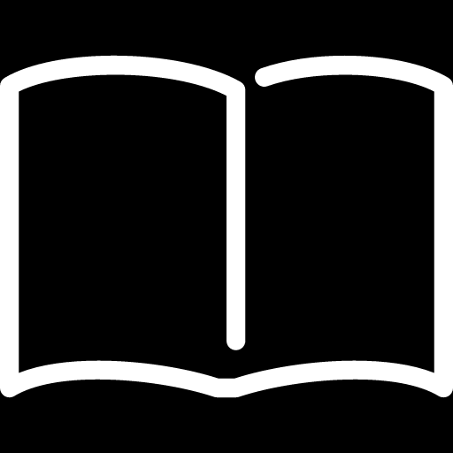
SOFTWARE REQUIREMENT SPECIFICATION
ソフトウェア要件仕様書
15

Slide 18




Software requirement specification
ソフトウェア要件仕様書
27 use cases
Manager
Receptionist
10 use cases
8 use cases
Common
3 use cases
Guest
Accountant
5 use cases
1 use case
16

Slide 19
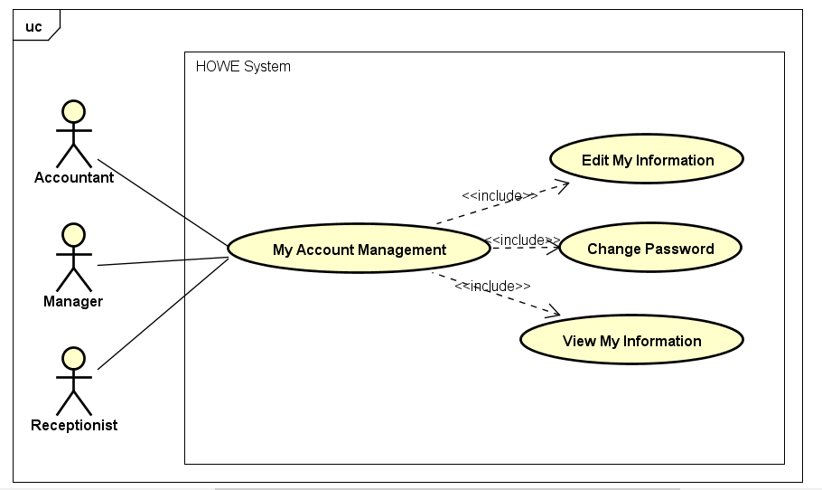

Software requirement specification
ソフトウェア要件仕様
Use Case Diagram
3 use cases
Common
Common use case diagram
17

Slide 20

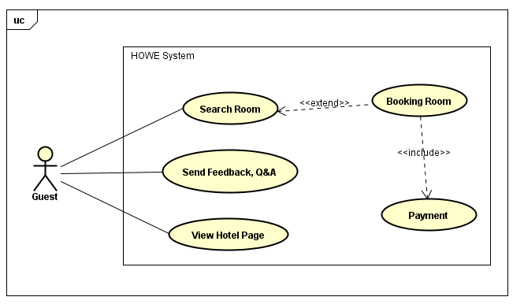
Software requirement specification
ソフトウェア要件仕様
Use Case Diagram
5 use cases
Guest
Guest use case diagram
18

Slide 21

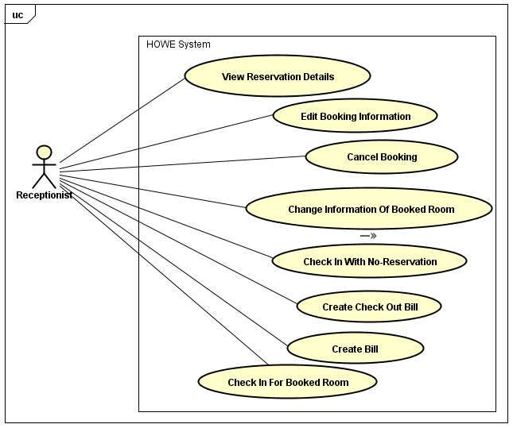
Software requirement specification
ソフトウェア要件仕様
Use Case Diagram
8 use cases
Receptionist
Receptionist use case diagram
19

Slide 22
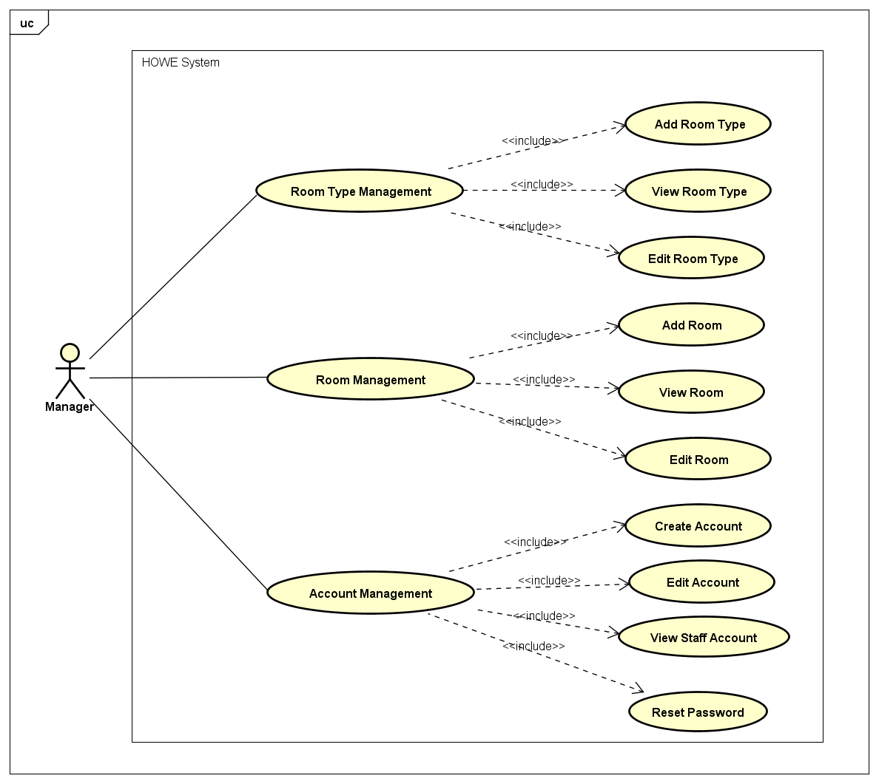
Software requirement specification
ソフトウェア要件仕様
Use Case Diagram
10 use cases
Manager
Manager use case diagram
20

Slide 23
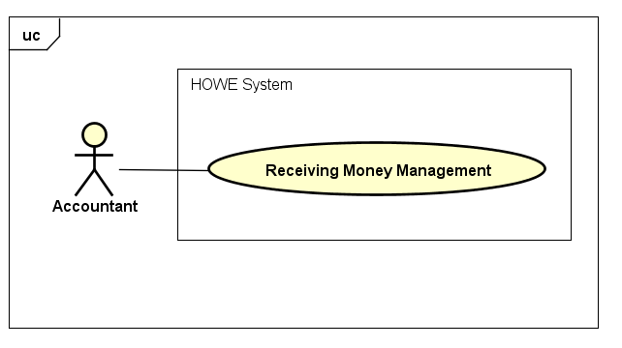
Software requirement specification
ソフトウェア要件仕様
Use Case Diagram
1 use case
Accountant
Accountant use case diagram
21

Slide 24
Software requirement specification
ソフトウェア要件仕様
Use Case ID: |  | UC005 | Version: | 1.0
Use Case Name: |  | Booking Room | Priority: | High
Created by: |  | QuyenTB | Date Created: | 29/05/2017
Actors: |  | Guest
Description: |  | This function allows actor to find and book a room
Trigger: |  | Click on “ĐẶT NGAY” button on the homepage
Extend Use Case: |  | UC004 – Search Room
Normal Flow
No | Actor Events |  | System Response
1 | Input quantity for each room type then click on “Tiếp theo” button
2 |  |  | Display confirmation booking page in the new tab
3 | Enter customer information then click on “Đặt phòng” button
4 |  |  | Display successfully message, display homepage, send booking information to customer’ mail
Use Case Writing of Booking Room Online (p1)
22

Slide 25
Software requirement specification
ソフトウェア要件仕様
Extension Flows
ET1 | At step 3
No | Actor Events |  | System Response
3.1 | Click on “x” button of confirmation tab
4.1 |  |  | Close confirmation tab
Exceptions:
EC1 | At step , number of room is not inputted
No | Actor Events |  | System Response
1.1 | Click on “Tiếp theo” button
2.1 |  |  | Display notification popup
EC2 | At step 3, data is not inputted
No | Actor Events |  | System Response
3.1 | Click on “Đặt phòng” button
4.1 |  |  | Display notification popup
Business Rules: |  | B1, B10
Other Information: |  | N/A
Use Case Writing of Booking Room Online (p2)
22

Slide 26
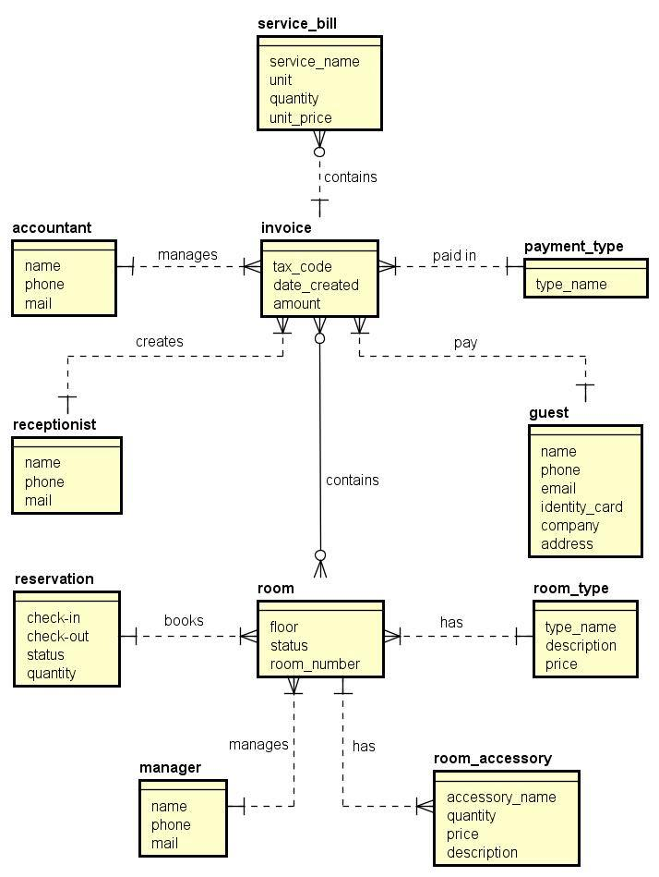
Software requirement specification
ソフトウェア要件仕様
Entity Relationship
Diagram
21

Slide 27

Software requirement specification
ソフトウェア要件仕様
Non – Functional Requirement
Usability
Interface should be beauty, simple, easy-to-use, clear.
The short, easy steps make it easy for actor to interact with the system immediately after training.
Provide an introduction to support users.
22

Slide 28


Software requirement specification
ソフトウェア要件仕様
Non – Functional Requirement
SUPPORTABILITY
Easy to maintain.
The website deployment and upgrade will be specified in the Installation Guide documents.
DESIGN CONSTRAINTS
Default date format: YYYY/MM/DD (example: 2017/05/29)
Default time format: HH(24):MM (example: 22:07)
Decimal places only 1-digit (example 2.2)
Decimal places of ‘%’ is 1-digit (example: 23.4%)
Currency: !#.#,00 (! is currency symbol, # is one or more digit)
23

Slide 29
SOFTWARE DESIGN DESCRIPTION
ソフトウェア 設計書
24

Slide 30
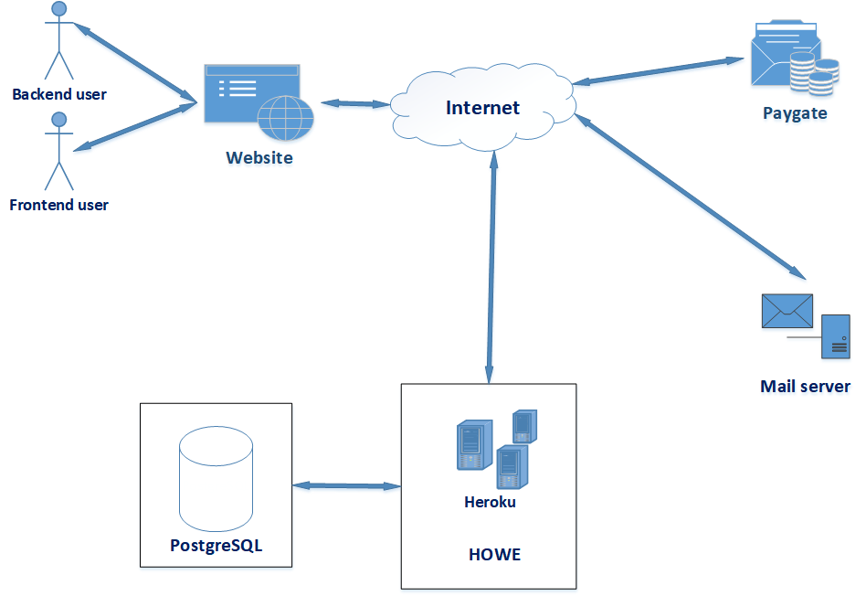
Software Design Description
System Architecture
26

Slide 31
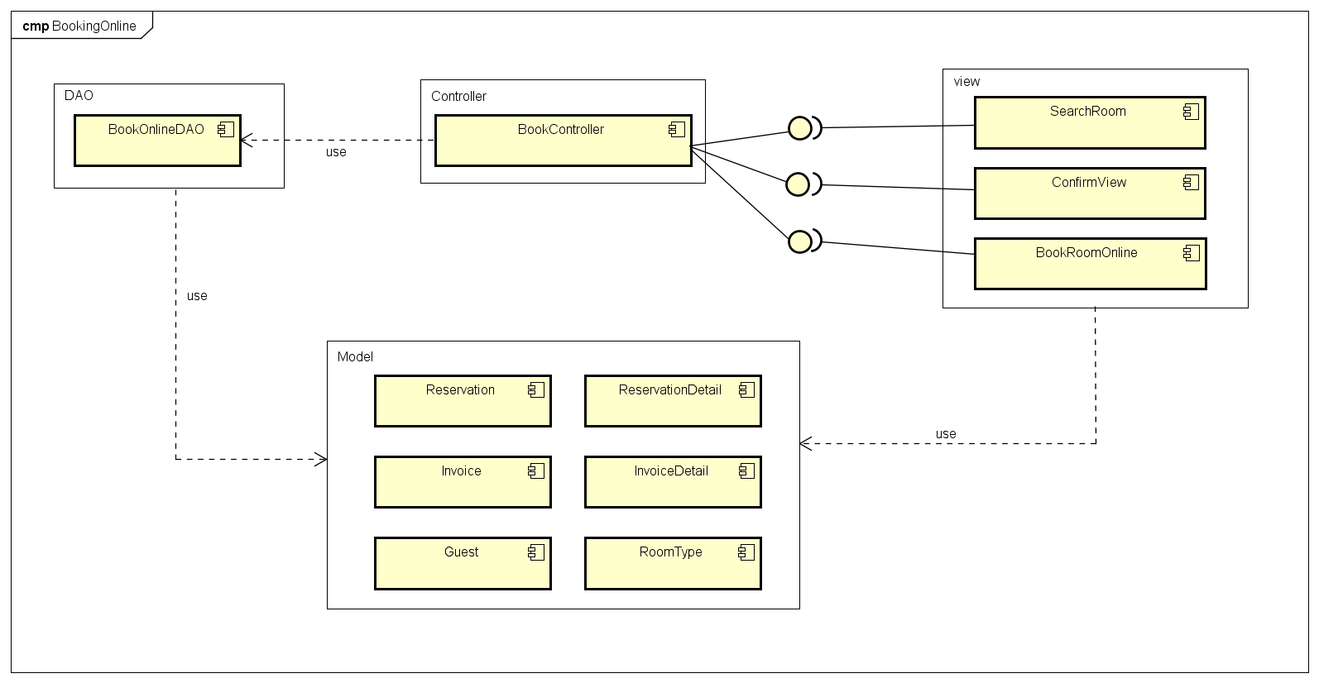
Software Design Description
Component
Diagram
Booking Online Component Diagram
28

Slide 32
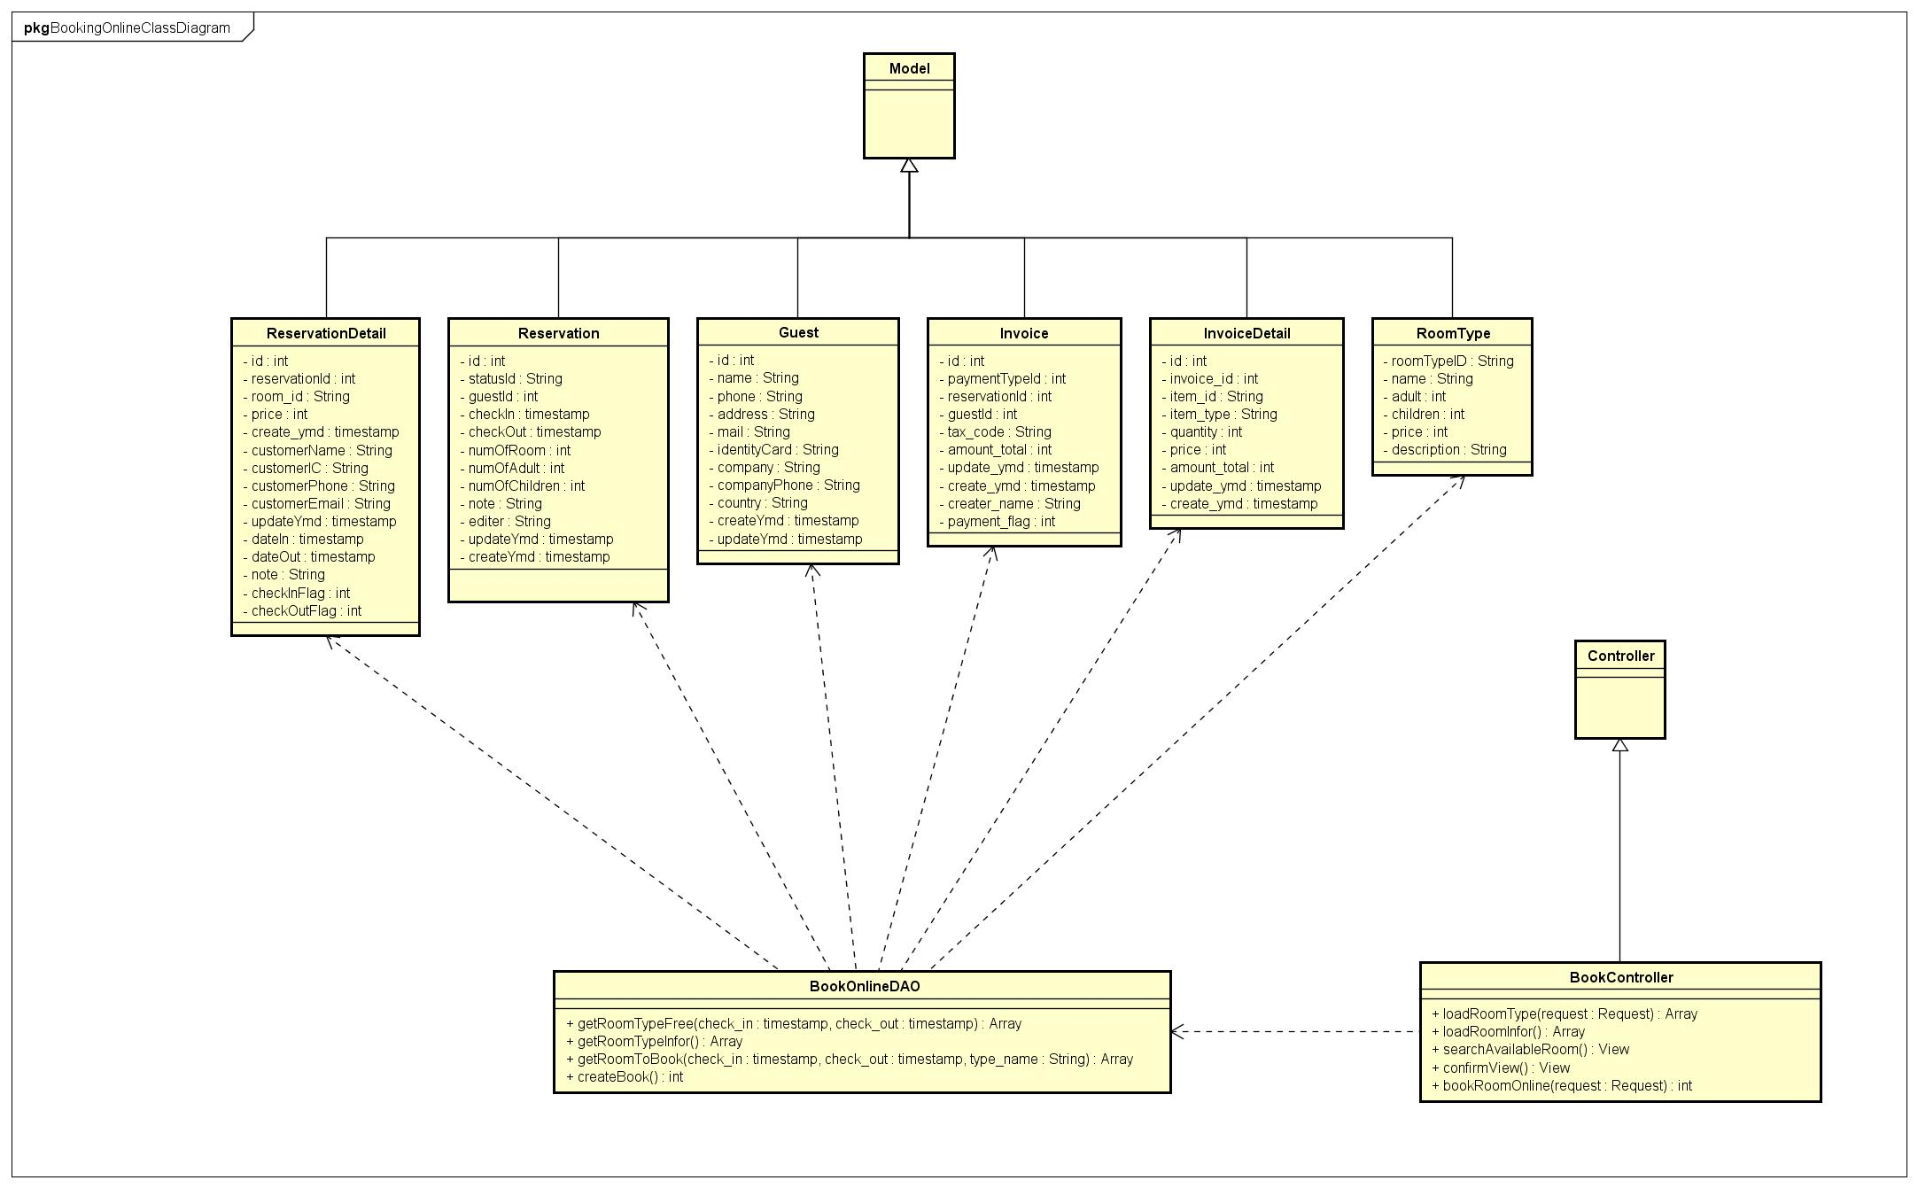
Software Design Description
Class
Diagram
Booking Online Class Diagram
29

Slide 33
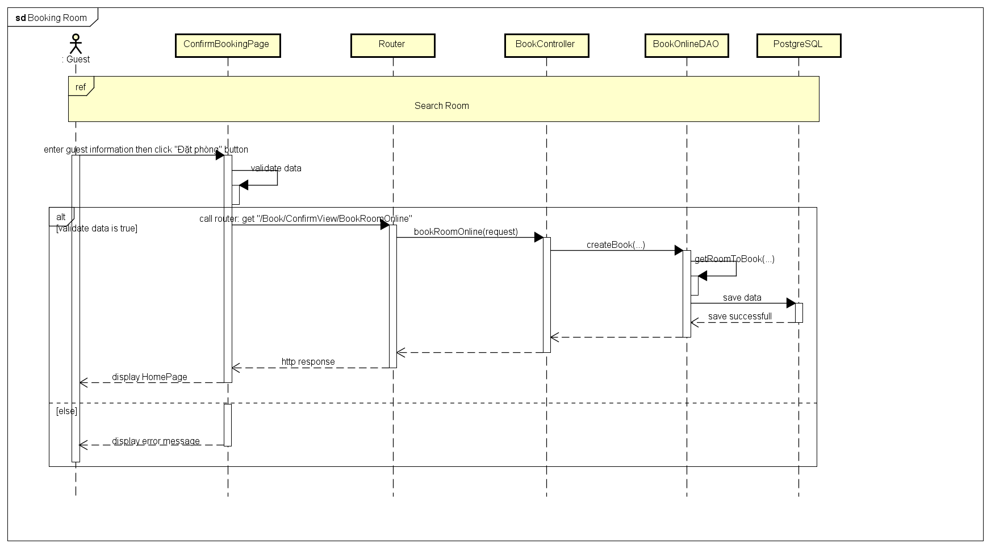
Software Design Description
Sequence Diagram
Booking Online Sequence Diagram
30

Slide 34
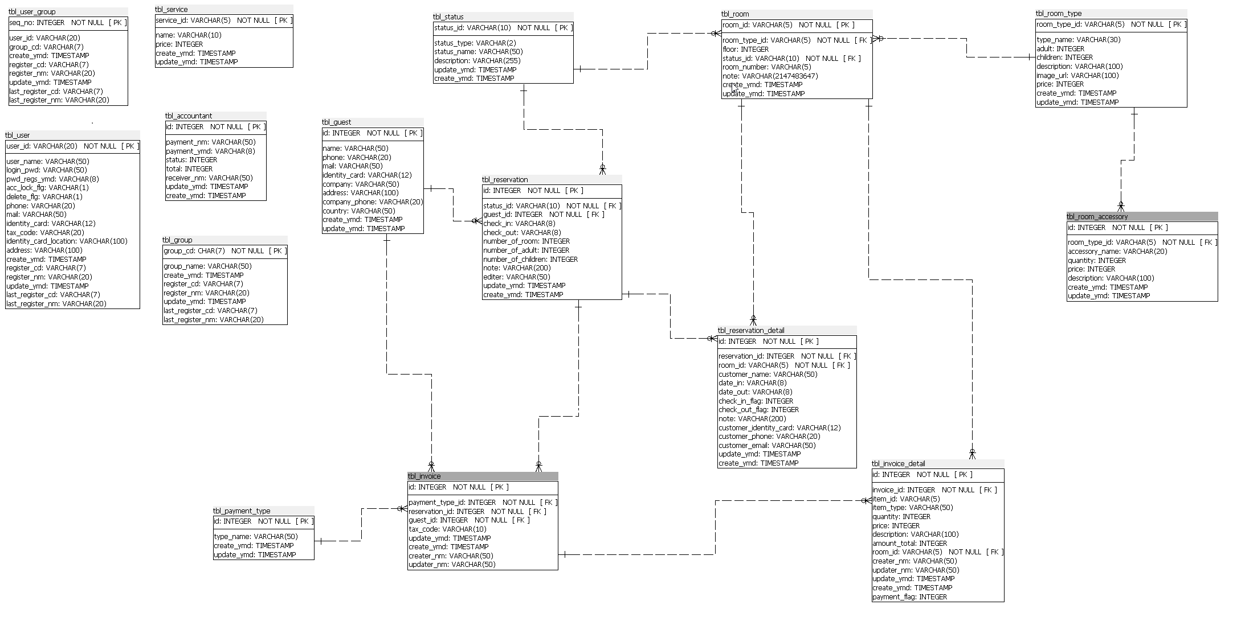
Software Design Description
Database
Design
27

Slide 35
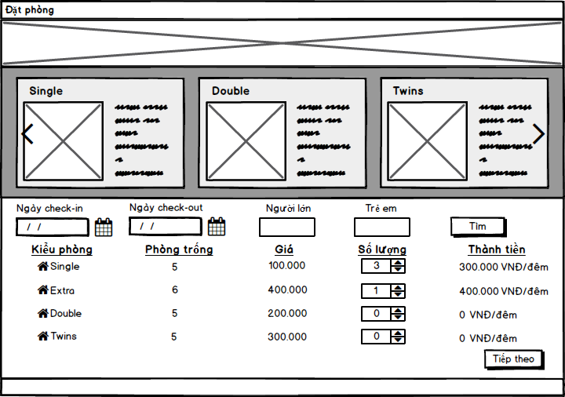
Software Design Description
Mockup of GUI
27

Slide 36



SOFTWARE TESTING
ソフトウェアテスト
31

Slide 37
Testing
01
Test Plan
02
Test Strategy
03
Test Process
04
PowerPointDep.net - website cung cấp các mẫu thiết kế hàng đầu về PowerPoint.
Test Cases
05
Test Report
06
34
Create Test Report

Slide 38
Testing
Test Plan
Base on Project Plan, Project Schedule, SRS to create Test Plan including:
Risks and contingencies
Features to be tested
Resources
Schedule
35

Slide 39


Test Environment and Tools
Testing
Microsoft Windows 10 Professional 64 bit
Google Chrome 60.0
Microsoft Office Word, Excel 2016
33

Slide 40
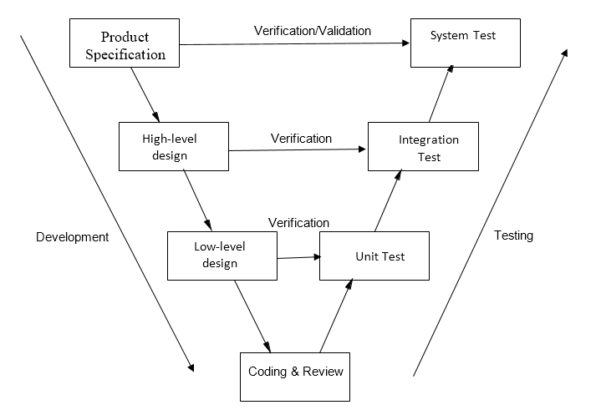
Testing
Test Strategy
V-Model
(FPT University’s SWQ Curriculum)
32

Slide 41
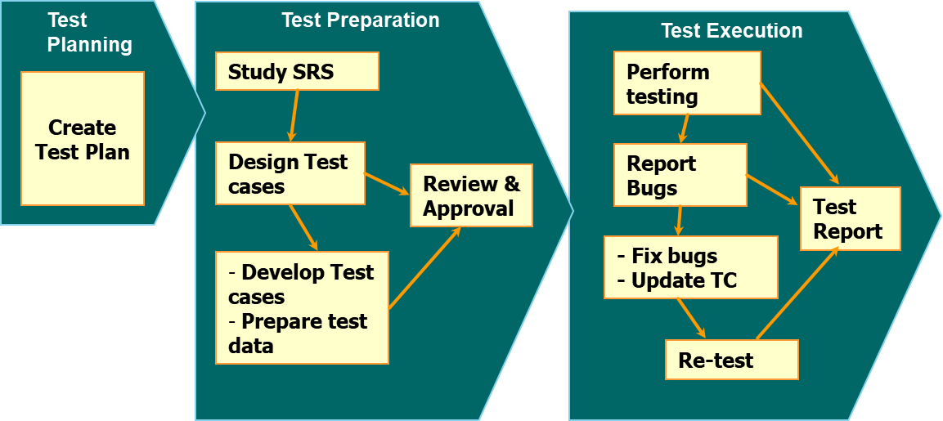
Testing
Test Process
FPT Software’s Testing Process
32

Slide 42

Testing
Test Case
01
Integration Test Case
02
System Test Case
37

Slide 43
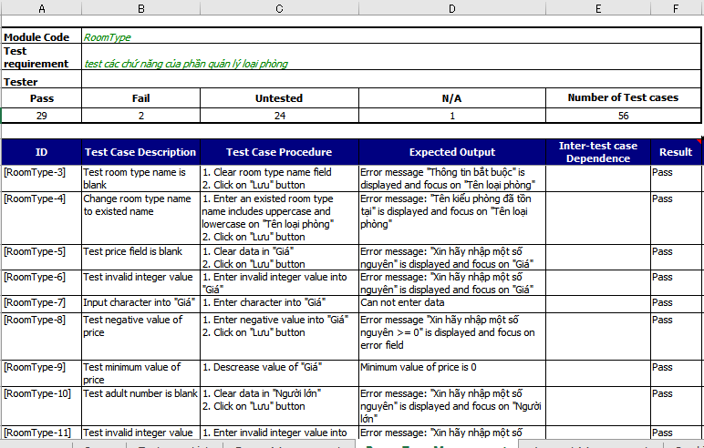
THIS IS A SLIDE TITLE
Testing
Test Case Sample
38

Slide 44
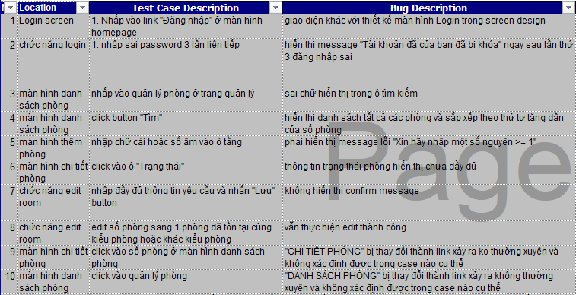
Testing
Defect bug
41

Slide 45
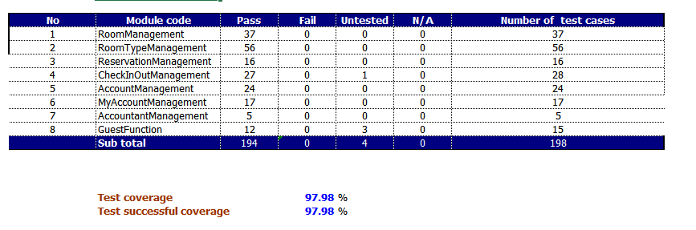
Testing
Test Report
Integration Test Report
43

Slide 46
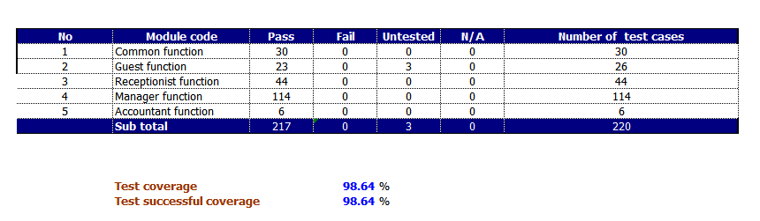
Testing
Test Report
System Test Report
43

Slide 47
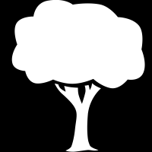
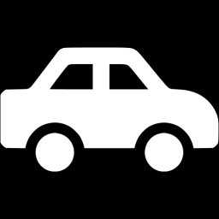
DEMO
デモ
46

Slide 48
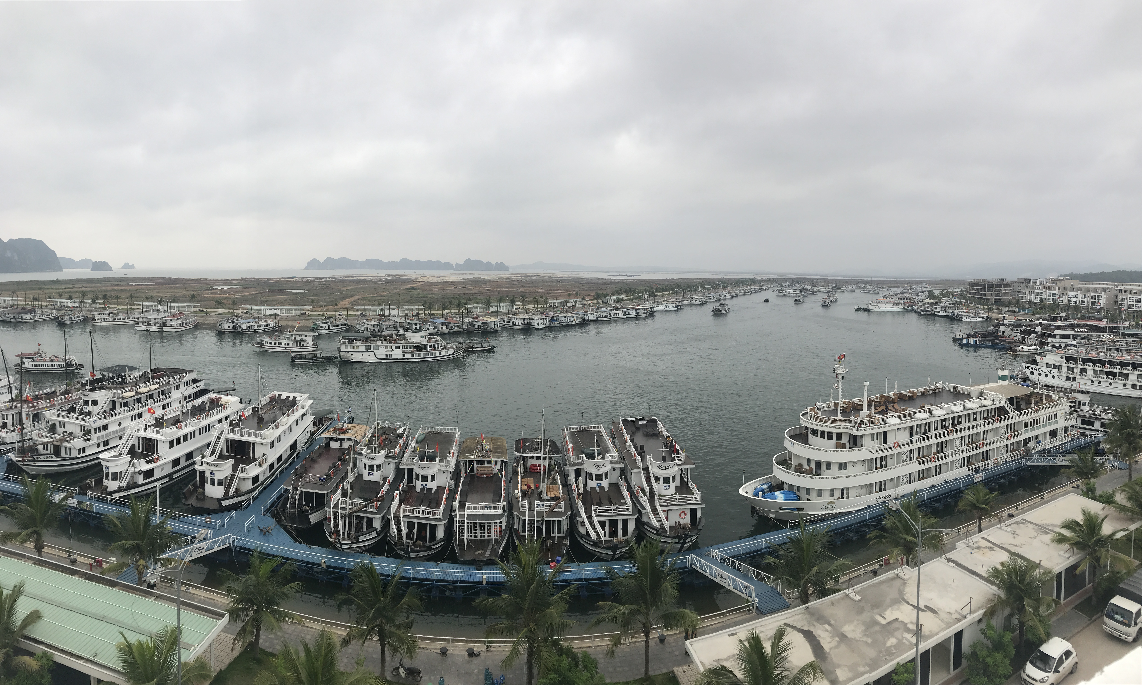
Thanks for watching
and
warmly welcome to AnhDuong Hotel!
48

Slide 49
Q&A
質問と回答

